Slide 1

Segmenting and Clustering Neighborhoods in Paris¶
Touristics places

Slide 2
Description
In my Capstone project I want to study the different tourist places by neighborhood of Paris, the city of lights. Study the different small activities around each tourist place such as restaurants, libraries, etc. Also study the correlation between the population by neighborhood and the number of restaurants and their type.

Slide 3
Data source
To do this project, I retrieve the data from the opendata site https://opendata.paris.fr/page/home/, by doing web scraping with beautifulsoup, or dowloading the data in a csv file or using the restful API.

Slide 4
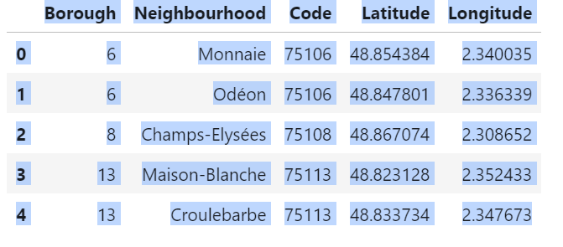
Data analysing and cleaning

Slide 5
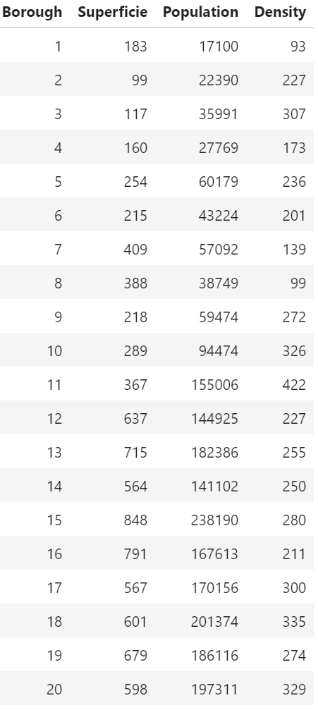
Paris's borough population

Slide 6
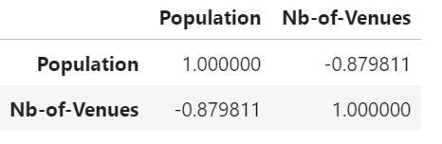
Correlation between venue’s number and population by Borough

Slide 7
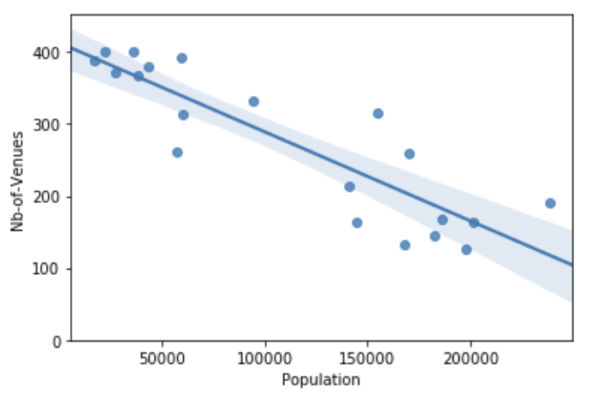
Venues and population graphic illustration

Slide 8
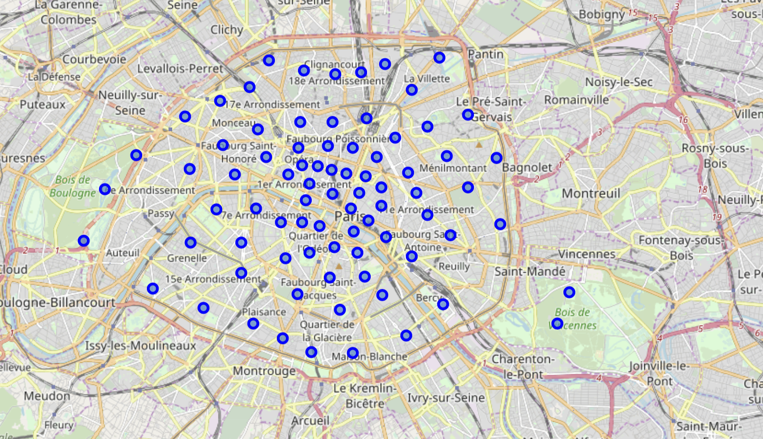
Paris’s Neighborhood

Slide 9
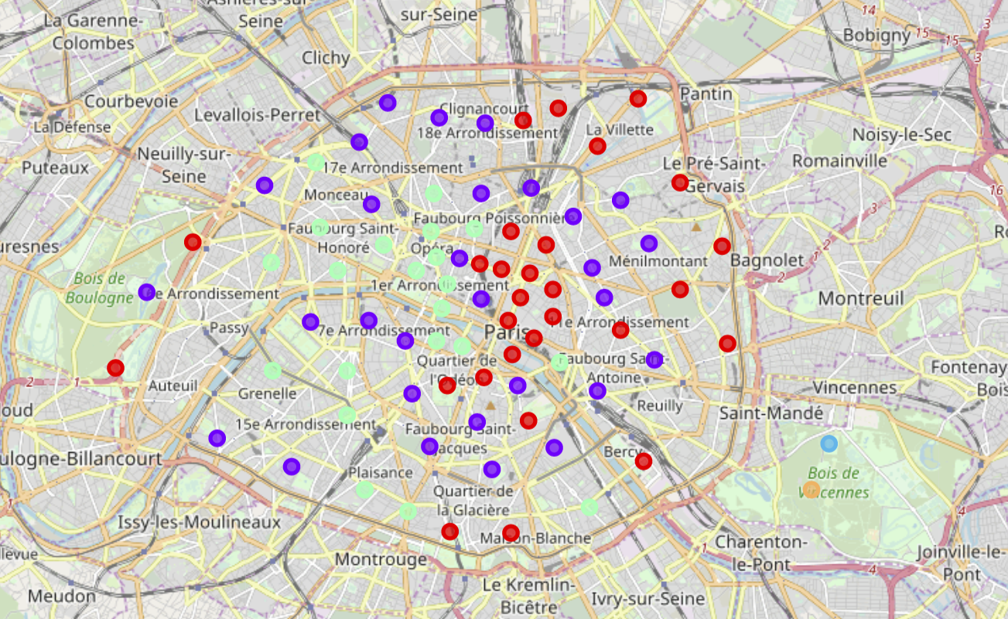
Paris’s venues by Neighborhood

Slide 10
Conclusion
After my analyse I can conclude that the correlation between number of venues and the population of borough is a negative correlation. But I can explain why.
The majority of Paris’ venues is concentrate in the borough center.

